Slide 1
File and Dataset Handling in Python

Slide 2
Course outline
Evaluate File and data set handling in Python (Module: use scikit-learn)
Discuss various format for data sets
Use Python to import various JSON and CSV files
Use Python to generate a random data set
Use Python modules to manipulate imported data and save them on disk
Evaluate File and data set handling in Python (Module: pandas)
Discuss various format for data sets
Use Python to import various JSON and CSV files
Use Python to generate a random data set
Use Python modules to manipulate imported data and save them on disk

Slide 3

Contents
What is File Format
Why understanding file formats
Various File formats
Handling CSV with Pandas
Handling JSON with Pandas
Scikit Learn

Slide 4
What is a file format
File format is a standard way of encoding information to store it in a file.
File format is nothing but structure of a file that tells a program how to display its contents
Firstly, a file format specifies whether the file is a binary file or ASCII file
Secondly it shows how the information is organized.
Some standard example is csv file format which stands for comma separated values file and stores all the data separated with a comma.

Slide 5
Why understanding different file formats
Usually, the type of file and its format depends on the application we are using for
We might come across many types of files such as audio, video and text etc.
Text files being the most used and simplest formats of all types
Text files have various formats, we need to understand each and every possible file format and the way in which the information is stored inside the file.
Unless we understand and know how the data is stored and displayed in specific file format we can’t explore and manipulate the data well from that file.

Slide 6
File Formats
Now let’s investigate various file formats, their structure and how data is stored in them. Also, how to use those file formats in python.
CSV – Comma separated Value
TSV – Tab Separated Value
XLSX – Microsoft excel open XML spreadsheet
TXT
JSON – Java Script Object Notation
XML - Extensible Markup Language
ZIP
HTML – Hyper Text Markup Language

Slide 7
CSV (Comma Separated Values)
Comma Separated values file format falls under spread sheet file format
Each line in a csv file is called a record
Each record may contain one or more than one value separated by a comma
Each record is separated from another record with a new line delimiter, which means each record in a csv file ends with a new line character and doesn’t have a trailing comma at the end

Slide 8
TSV (Tab Separated Values)
Tab Separated values file format falls under spread sheet file format
Tab separated values files format is similar to csv file format
Each record may contain one or more than one value separated by a tab
Each record is separated from another record with a new line delimiter, which means each record in a tsv file ends with a new line character and doesn’t have a trailing tab at the end

Slide 9
TSV
CSV
First name,Last Name,Mobile,Country
Tom,Holland,123456789,USA
Michael,Stark,3452184,Canada
Howard,Hogan,142783452,Mexico
Sheldon,Cooper,23451672,Trinidad
Sam,Billings,345217926,England
First name Last Name Mobile Country
Tom Holland 123456789 USA
Michael Stark 3452184 Canada
Howard Hogan 142783452 Mexico
Sheldon Cooper 23451672 Trinidad
Sam Billings 345217926 England

Slide 10
XLSX (Microsoft Excel open XML spreadsheet)
This also falls under Spreadsheet file category
Data is stored in cells. Each cell is organized in rows and columns.
A column can have different types.
XLSX files can be opened using only applications which support the file format.
They can be opened by Microsoft excel. For example, if an excel file is opened with a normal text editor like notepad it displays the encodings but not the data.

Slide 11
JSON
JSON stands for Java Script Object Notation
JSON is a lightweight data interchange format
JSON data format is similar to java script object notations
JSON syntax is derived from Java script objects:
Data is in the form of key/value pairs
Data is separated by commas
Curly Braces hold objects
Square brackets hold arrays

Slide 12
JSON
Key Value pair in JSON consists of a field name (key) in double quotes, followed by a colon, followed by a value in double quotes
In JSON Keys can be strings, numbers or identifier names
In JSON values must be one among the following data types
A string
A number
An object
An array
A Boolean
A null

Slide 13
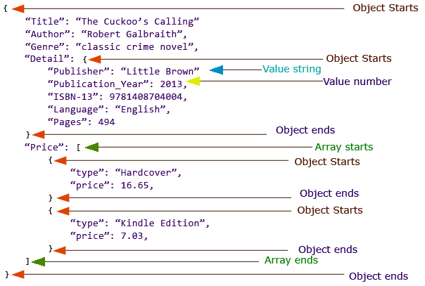
JSON (Java Script Object Notation)
This image shows different parts in a json file.

Slide 14
ZIP files
Zip file is an archive file format and has an extension .zip
In Archive file format, you create a file that contains multiple files along with metadata. An archive file format is used to collect multiple data files together into a single file. This is done for simply compressing the files to use less storage space.
So, a ZIP file format is a lossless compression format, which means that if you compress the multiple files using ZIP format you can fully recover the data after decompressing the ZIP file.

Slide 15
Plain text file format
Plain text file format has an extension .txt
This text is unstructured and there is no metadata associated with the text
The txt file can be easily created and read by using any program
Interpreting data and analyzing data in a text file is very difficult because it doesn’t represent any standard structure
Text files are generally useful when you want to load a huge amount of unstructured paragraphs of data for applications such as NLP

Slide 16
XML (Extensible Markup Language)
XML is markup language much like HTML, only difference being the tags in XML are not predefined and XML is self descriptive
First line of XML file contains a prolog <?xml version="1.0" encoding="UTF-8"?>
The XML prolog is optional. If it exists, it must come first in the document.
XML documents must contain one root element that is parent to all other elements
Every XML tag must have a closing tag. <a> text </a>

Slide 17
Handling ZIP file in Python
We can work with Zip files by importing the zipfile package in python
ZipFile is a class of zipfile module for reading and writing zipfiles
ZipFile constructor is used to open zip file in read or write mode
ZipFile.printdir() method is used to print all the contents of zip file
ZipFile.extractall() method is used to extract all the contents of the zip file and store them in the current working directory.

Slide 18
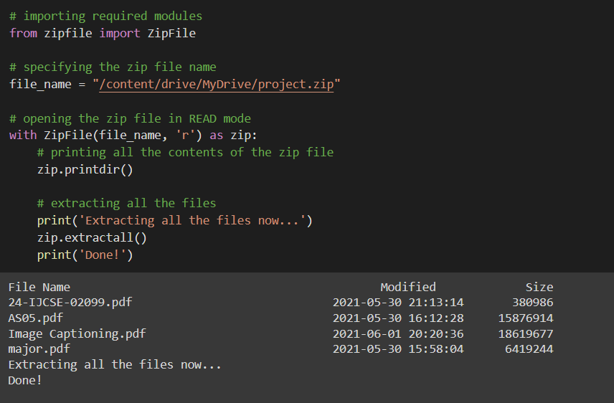
Handling ZIP file in Python

Slide 19
Handling plain text file in Python
Text file handling doesn’t require any special library to be used
open(filename,accessmode) method creates a file object pointing to the specific file.
Access Modes of opening the file are
‘r’ – read only mode
‘r+’ – read and write mode
‘w’ – write only mode
‘w+’ – write and read mode
‘a’ – append only mode
‘a+’ – append and read mode

Slide 20
Handling plain text file in Python
file.close() is used to close a file
file.write() is used to write a single line and writelines() is used to write set of lines each at a time
File.read(n) reads n bytes from file, if n is not specified reads the entire file
readlines() reads all the lines and return them as each line a string element in a list

Slide 21
Handling ZIP file in Python
We can work with Zip files by importing the zipfile package in python
ZipFile is a class of zipfile module for reading and writing zipfiles
ZipFile constructor is used to open zip file in read or write mode
ZipFile.printdir() method is used to print all the contents of zip file
ZipFile.extractall() method is used to extract all the contents of the zip file and store them in the current working directory.

Slide 22
Importing CSV files with Pandas
Pandas is a python library for data manipulation and analysis
Pandas library can be used to import, manipulate, process and create files in different forms such as CSV, TSV and JSON etc.
To read CSV files using Pandas, pandas’s read_csv() function is used
Pandas library can be imported as follows
import pandas as pd

Slide 23
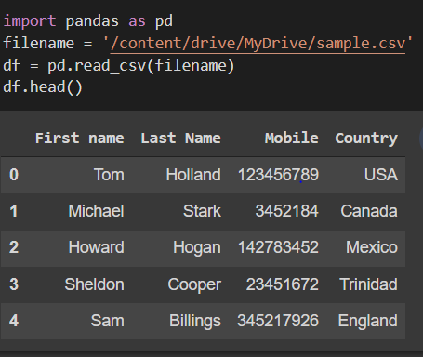
Importing CSV files with Pandas
read_csv() function returns the data present in csv file as a dataframe
Filename is passed into the read_csv() function
Instead of file name an URL can also be passed
URL consisting the file
Other parameters are set to default
Df is a data frame and data gets stored in it
Df.head() displays the first 5 rows

Slide 24
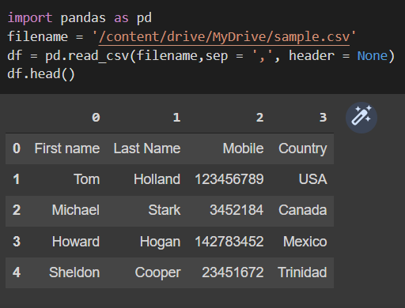
Importing CSV files with Pandas
pd.read_csv(filename, sep, header)
Sep is an optional argument and by default it has a value ‘,’. To process csv files separated with other delimiters such as tab and ‘;’ we can mention sep explicitly.
By default, first line of file is considered as header. But if header = None is specified then it is not considered

Slide 25
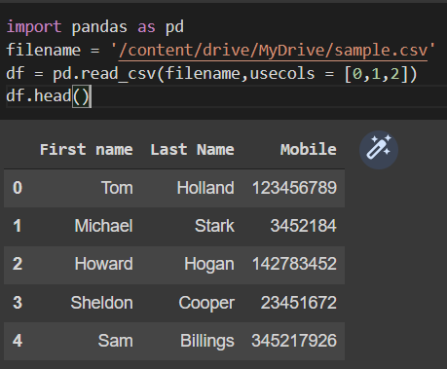
Importing CSV files with Pandas
pd.read_csv(filename, usecols)
Usecols is used to get subset of columns
Usecols parameter takes list of values as input
List can contain numbers representing the indices of the columns or it can have the names of the columns as strings
As we can see country whose index is 3 is not imported into the data frame

Slide 26
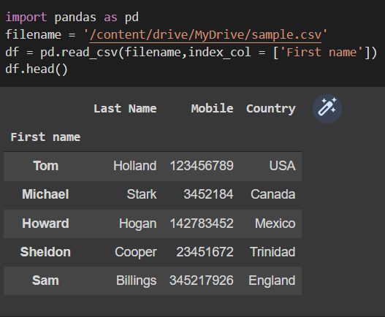
Importing CSV files with Pandas
pd.read_csv(filename, index_col)
From the previous outputs we can see the index getting generated as per the order of records in the input file
We can generate index column explicitly using a column or set of columns using index_col parameter

Slide 27
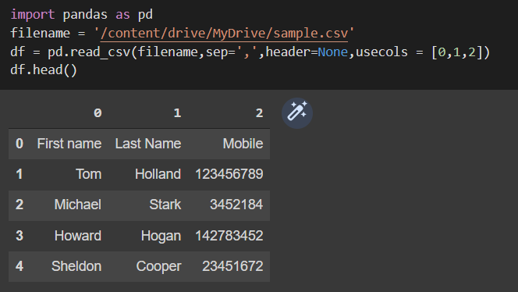
Importing CSV files with Pandas
importing data from csv file with separator as ‘,’ and no header with subset of first 3 columns and default indices.

Slide 28
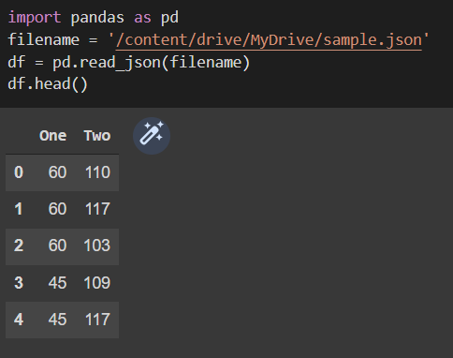
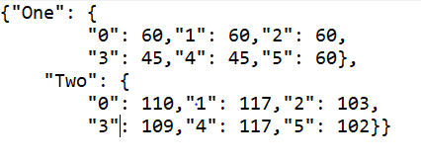
Importing JSON files with Pandas
read_json() function returns the data present in json file as a dataframe
Filename is passed into the read_json() function
Instead of file name an URL can also be passed
Other parameters are optional and set to defaults

Slide 29
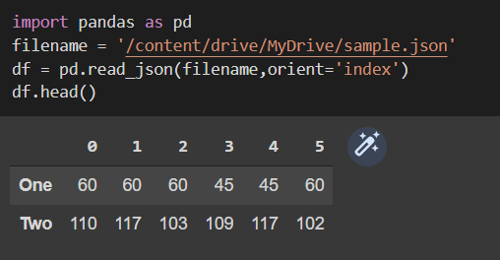
Importing JSON files with Pandas
Read_json(filename, orient)
By default, the orient is set as None
If the orient parameter is explicitly set to ‘index’ we get output data frame as dict like index->{column->Value}
If orient is set as ‘column’ then we get dict like column -> {index->value}

Slide 30
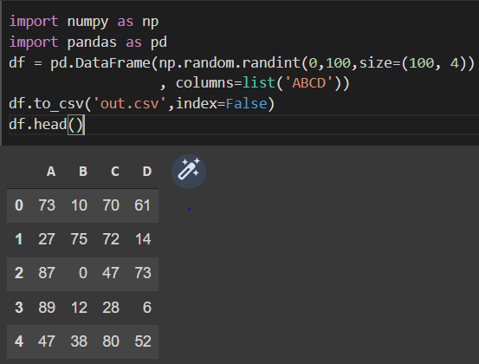
Generating Random Data with Pandas
Pandas data frame can be used to convert the data which is randomly generated using numpy library random module
Later the generated data stored in a pandas data frame can be converted into suitable file format and stored for further use.

Slide 31
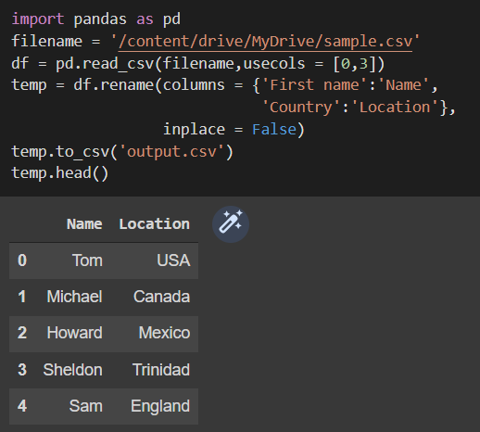
Manipulating data with Pandas
Let us take a sample CSV file which we have seen earlier.
Load the CSV file and take data only from First name and country columns
Then rename the columns as Name and location. Inplace = False parameter is used to specify creation of new dataframe rather than updating the used dataframe.
To_csv() function is used to convert the data frame into csv file and store it on disk

Slide 32
Scikit Learn
Scikit Learn which stands short for scientific kit learn is a library in Python
Scikit Learn library is a the most useful and robust library for machine learning in python
It provides a selection of efficient tools for machine learning and statistical modeling including classification, regression, clustering and dimensionality reduction via a consistence interface in Python.
It can be imported as import sklearn

Slide 33
Scikit Learn Datasets
For ease of testing various programs and machine learning algorithms sklearn provides 7 pre-built datasets in datasets module of sklearn
They can be imported by using import sklearn.datasets
Load_boston()
Load_breast_cancer()
Load_diabetes()
Load_digits(n_class)
Load_iris()

Slide 34
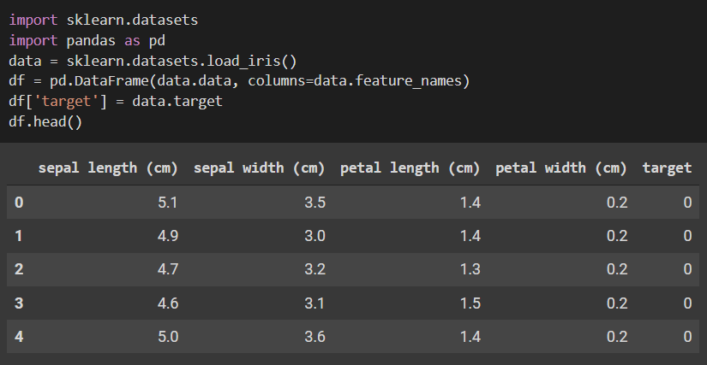
Scikit Learn Datasets
Loading iris data set from Sklearn. It is in the format of numpt ndarray. So we convert it into pandas Dataframe and then perform data manipulation.

Slide 35
Generate datasets using sklearn
We have already seen various datasets that are available in sklearn
Sklearn module also allows us to generate random datasets
There are two types for which datasets can be generated using sklearn
Methods to generate datasets for classification
Methods to generate datasets for Regression

Slide 36
Methods to generate datasets for Classification
Make_moons & make_circles
2-dimensional dataset for creating a binary classifier
Make_classification
random datasets which can be used to train classification model
This dataset can have n number of samples specified by parameter n_samples.
2 or more number of features (unlike make_moons or make_circles) specified by n_features, and can be used to train model to classify dataset in 2 or more classes

Slide 37
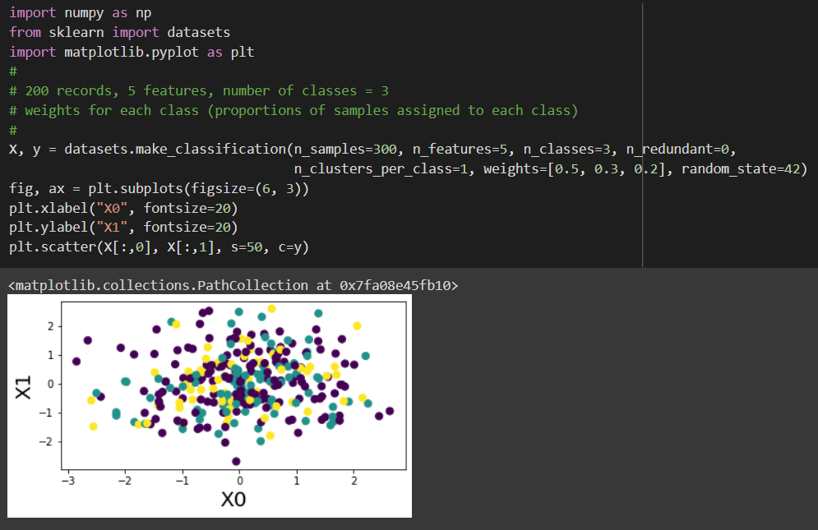
Methods to generate datasets for Classification

Slide 38
Methods to generate datasets for Regression
make_regression:
Sklearn.datasets.make_regression method can be used to generate datasets which could be used to solve train regression models using different regression algorithms.
Some of the important attributes which can be fed into make_regression methods are n_samples (number of records), n_features (number of features), n_informative (number of informative features) etc.
Let’s see how the make_regression method is used to generate random datasets (200) with 5 features while having 2 informative features.

Slide 39
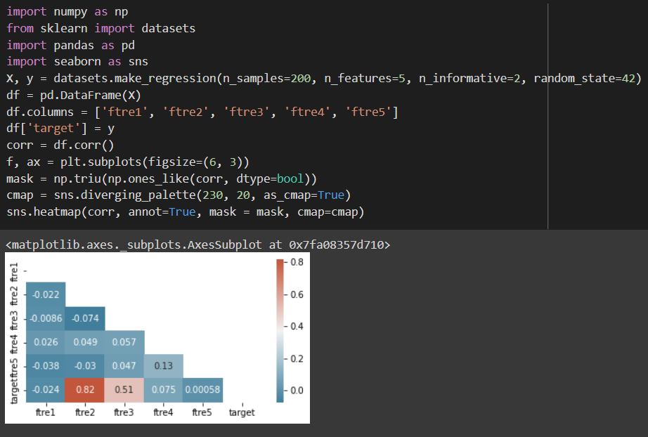
Methods to generate datasets for Regression

Slide 40
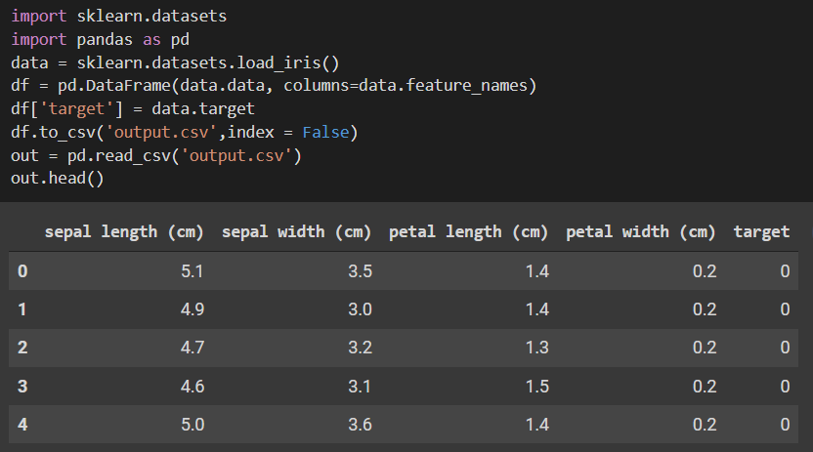
Manipulating and storing data with sklearn
Loading iris data set from sklearn
Converting the dataset from numpy ndarray format to pandas data frame
Storing the data frame on to disk as a csv file
Reusing the csv file from disk

Slide 41
Assignment on dataset handling using Python
Import an XML file using python
Import a JSON file and analyze how different parts of JSON file can be parsed according to the business use case
Import the breast cancer dataset from sklearn library and attach the target variable data to the features data and store it in a JSON file
Make a regression dataset (500) with 7 features while having 4 informative features and store them on disk in a csv file

Slide 42
Summary

Slide 43
Q&A

Slide 44
References
https://www.analyticsvidhya.com/blog/2017/03/read-commonly-used-formats-using-python/
https://pandas.pydata.org/docs/reference/api/pandas.read_csv.html
https://www.geeksforgeeks.org/different-ways-to-import-csv-file-in-pandas/
https://www.knowledgehut.com/tutorials/machine-learning/model-building-scikit-learn-python-library-machine-learning
https://towardsdatascience.com/generate-your-sample-dataset-a-must-have-skill-for-data-scientists-36ded8600b79
https://vitalflux.com/python-sklearn-how-to-generate-random-datasets/

